Slide 1
ASP.Net

Slide 2
What’s in a Name?
vNext
ASP.Net Version 5
ASP.Net Core 1.0

Slide 3
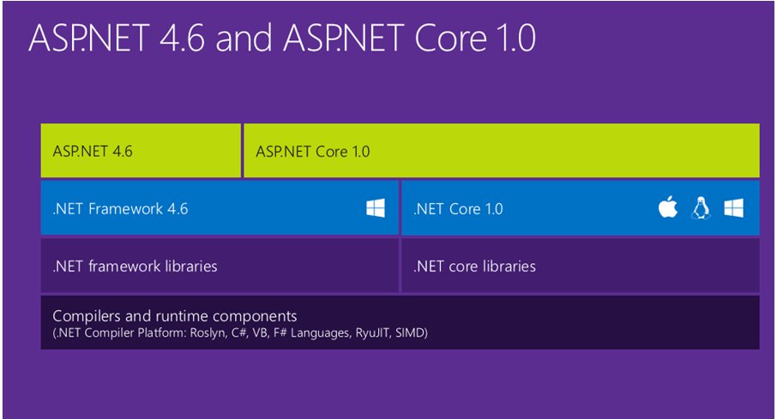
ASP.Net 5 is Dead, Long Live ASP.Net Core 1.0

Slide 4
ASP.Net Core 1.0
ASP.Net 5 is now ASP.Net Core 1.0
.Net Core 5 is now .Net Core 1.0
Entity Framework 7 is now Entity Framework Core 1.0 (EF Core 1.0)
DNX is now dotnet
Dotnet restore
Dotnet run
Dotnet build
https://get.asp.net/

Slide 5
When Unbundling Is Good
Not monolithic anymore
Static Files
Identity
MVC 6
TagHelpers
EF7 now EF Core 1.0
Pick your data provider
Bootstrap
Bower
Gulp
…
Kestrel - - Over 1 million requests per second (rps).

Slide 6
You Too Can Command Line…
Cross platform command line tools
dnvm – DotNet Version Manager
dnu – DotNet Utilities
dnx – DotNet eXecutable runtime.
Cross platform command line tools REBOOTED
dotnet…
run
compile
restore
publish
…

Slide 7
Some Good Places To Look
https://get.asp.net/
https://github.com/dotnet/cli/blob/master/Documentation/intro-to-cli.md/
http://johnatten.com/2015/05/17/dnvmdnx-and-dnu-understanding-the-asp-net-5-runtime-options/
http://www.hanselman.com/blog/ASPNET5IsDeadIntroducingASPNETCore10AndNETCore10.aspx/
http://thedatafarm.com/data-access/ef7-is-now-ef-core-1-0-package-and-namespaces-change-tool/
http://weblog.west-wind.com/posts/2016/Jan/21/Microsoft-renames-ASPNET-5-to-ASPNET-Core-10/
https://live.asp.net/
http://www.inversionofcontrol.co.uk/
http://blog.tonysneed.com/
https://docs.asp.net/en/latest/
http://benfoster.io/
https://blogs.msdn.microsoft.com/webdev/2016/02/01/an-update-on-asp-net-core-and-net-core/

Slide 8
Some Good Places To Look (cont.)
http://www.sblackler.net/2015/05/02/Up-And-Running-With-DNX-DNVM-DNU/
http://developer.telerik.com/featured/net-developers-love-thy-command-line/
http://tostring.it/2016/01/12/Using-Kestrel-with-ASPNET-5/
Plural Sight has “Building a Web App with ASP.NET 5, MVC 6, EF7, and Angular JS” by Shawn Wildermuth

